Slide 1
YOLO-CFAR: a Novel CFAR Target Detection Method Based on YOLO
林郁庭(2021)。基於YOLO之雷達目標偵測演算法。國立清華大學通訊工程研究所碩士論文，新竹市。 取自 https://hdl.handle.net/11296/7n49t5
Advisor: Dr. Chih-Yu Wang
Presenter: Shao-Heng Chen
Date: June 29, 2022

Slide 2
Outline
1. Introduction
2. Constant False Alarm Rate (CFAR) detectors
3. Dynamic Range Compression (DRC) preprocessing
4. Proposed YOLO-CFAR algorithm
5. Conclusions and future works
1

Slide 3
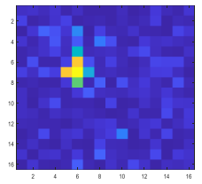
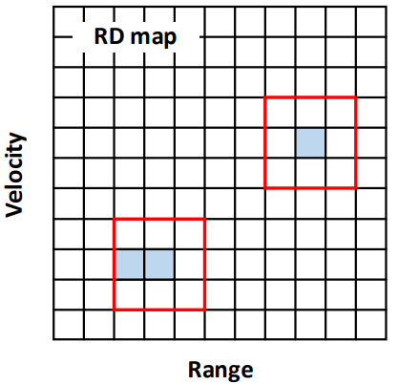
Introduction
1. Radar signal detection
– determine whether a target exists in a clutter or noisy environment
– if a radar signal beyond a certain threshold, we then regard it as the target
2. Constant false alarm rate
– maintain a desired false alarm rate through an adaptive threshold
2

Slide 4
CFAR detectors
– CFAR detectors adaptively adjust the detection threshold by using the
surrounding samples (reference cells) info to estimate the noise level
– Conventional ones: CA-CFAR, GO-CFAR, SO-CFAR, OS-CFAR, DL-CFAR
– Poor performance in multi-target or clutter scenarios (non-homo. scenarios)
3

Slide 5
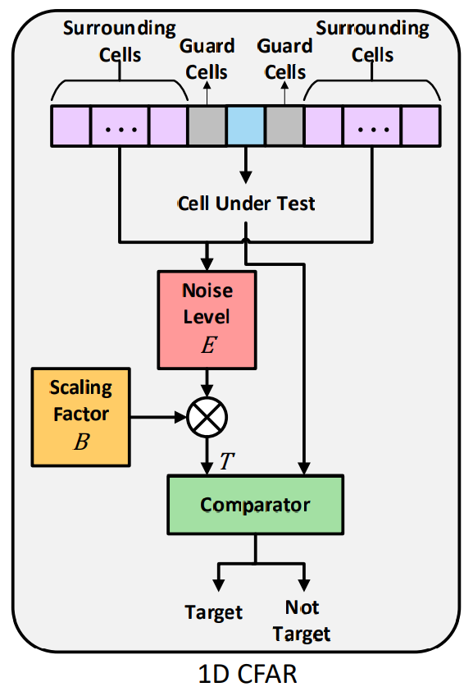
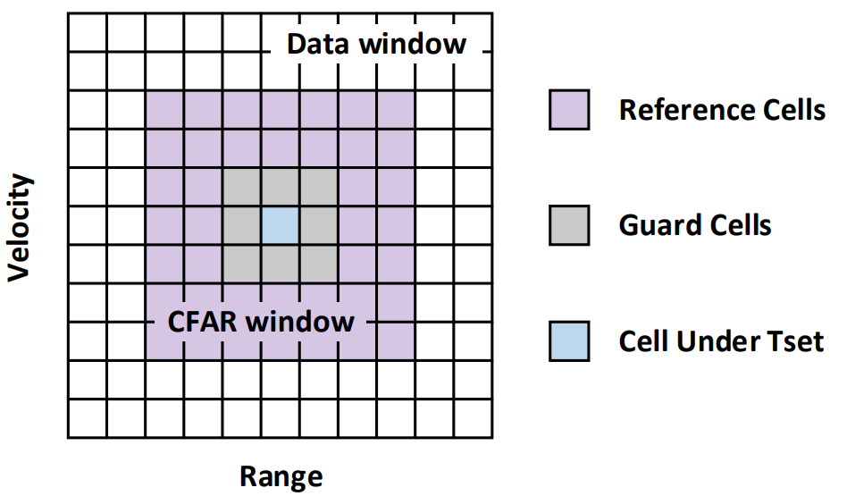
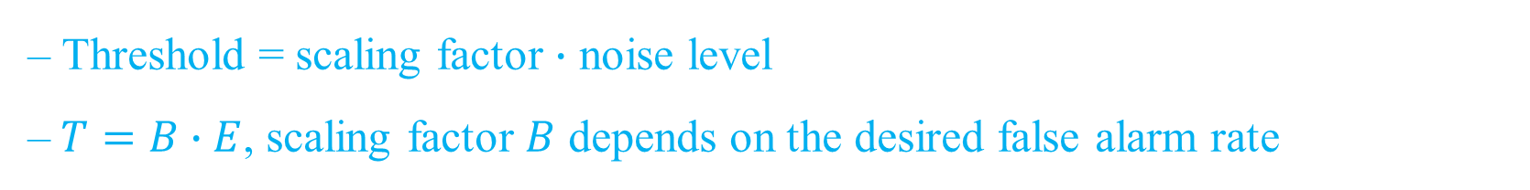
CFAR detectors
– Threshold = scaling factor $∙$ noise level
$\text{–} T=B∙E$, scaling factor $B$ depends on the desired false alarm rate
4

Slide 6
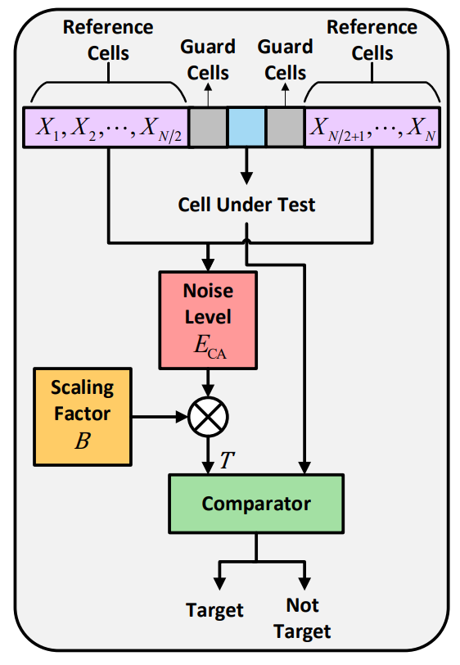
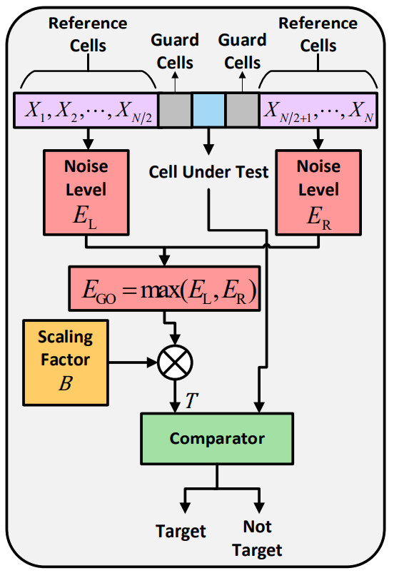

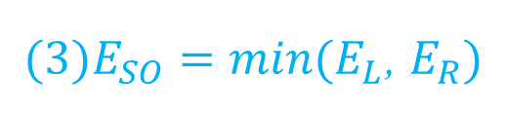
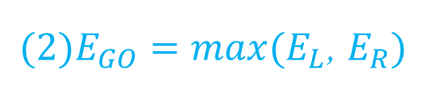
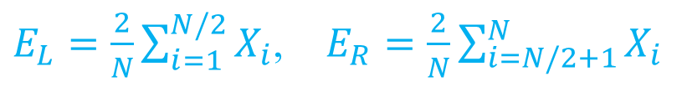
CA-CFAR, GO-CFAR, SO-CFAR
– N is the total number of references cells
$E_{L}=\frac{2}{N}\sum_{i=1}^{N/2}{X_{i}}$, $E_{R}=\frac{2}{N}\sum_{i=N/2+1}^{N}{X_{i}}$
$\left(1\right)E_{CA}=\frac{1}{N}\sum_{i=1}^{N}{X_{i}}$
$(2)E_{GO}=max⁡(E_{L}$, $E_{R})$
$(3)E_{SO}=min⁡(E_{L}$, $E_{R})$
5
Notes:
CA-CFAR 很直觀 估計就直接取平均
GO-CFAR 主要作用是 降低 false alarm rate
SO-CFAR 主要作用是 想要解決相鄰目標間的遮蔽問題

Slide 7
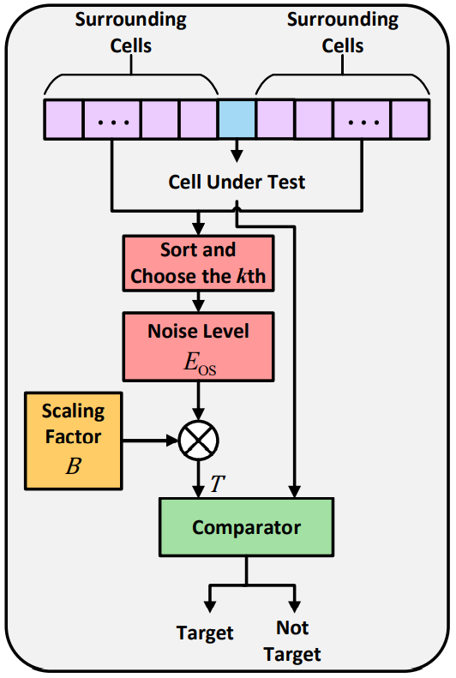
OS-CFAR
– The noise level is estimated by the k-th smallest surrounding cells
– Set k = 3N/4 in practical applications
– Effective in multi-target scenario
6
Notes:
OS-CFAR 主要作用是 想要解決密集目標間的遮蔽問題
方法很簡單 就是把功率由小到大排序 然後取第k個樣本作為估計的noise level

Slide 8
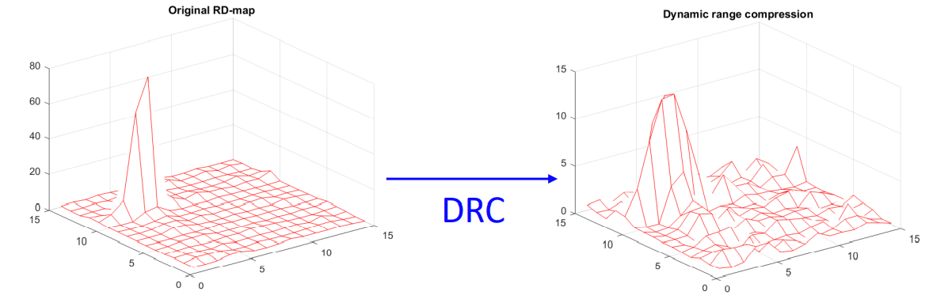
Dynamic Range Compression
– DRC is commonly used in audio signal processing
– Suppress loud sounds or amplifies quiet sounds which makes the feature more obvious
7

Slide 9
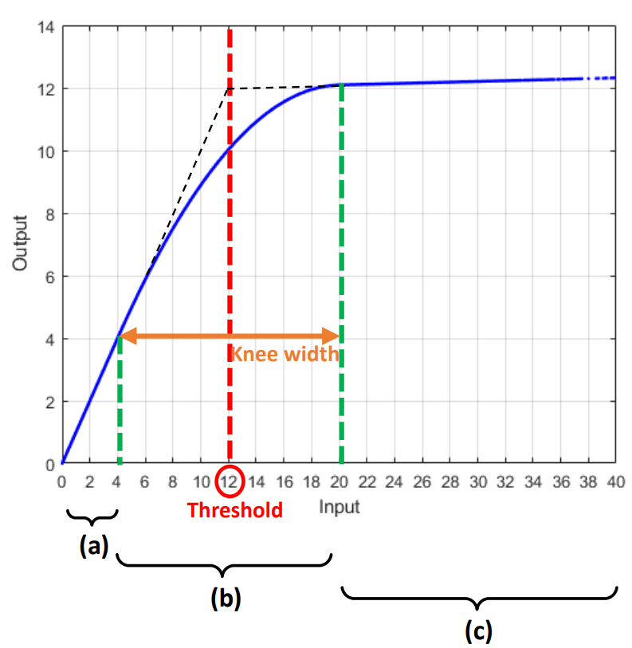
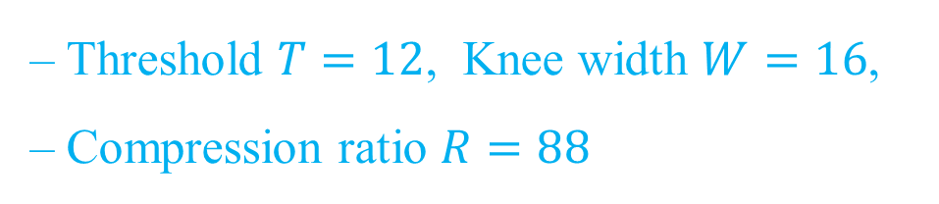
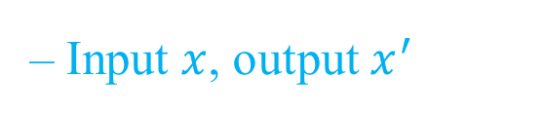
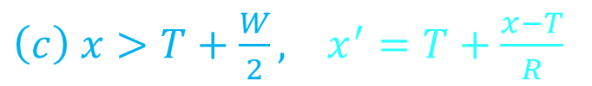
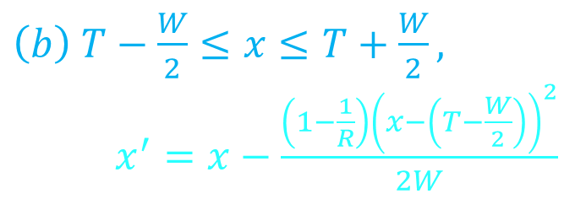
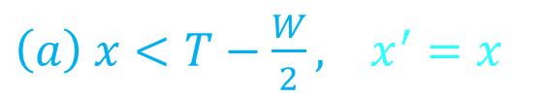
Dynamic Range Compression
– Input $x$, output $x^{′}$
$\left(a\right) x<T−\frac{W}{2}, x^{′}=x$
$\left(b\right) T−\frac{W}{2}≤x≤T+\frac{W}{2},$
$x^{′}=x−\frac{\left(1−\frac{1}{R}\right){\left(x−\left(T−\frac{W}{2}\right)\right)}^{2}}{2W}$
$\left(c\right) x>T+\frac{W}{2}, x^{′}=T+\frac{x−T}{R}$
– Threshold $T=12$, Knee width $W=16$,
– Compression ratio $R=88$
8

Slide 10
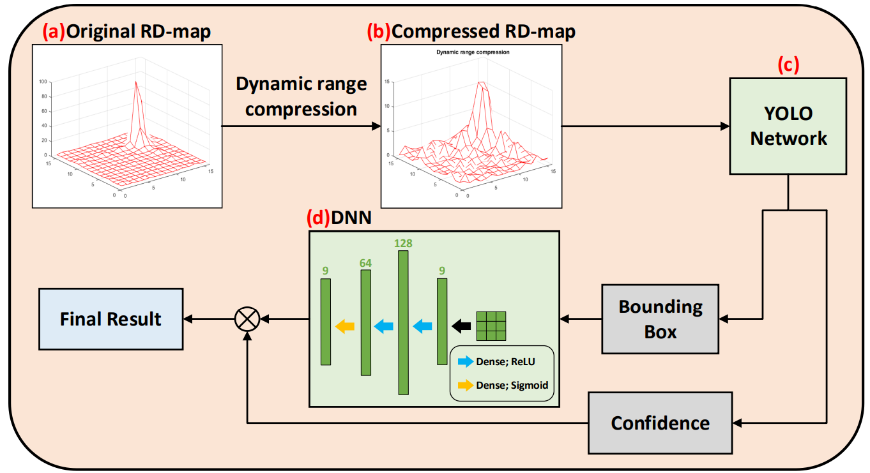
YOLO-CFAR
– Overview of the proposed YOLO-CFAR
9

Slide 11
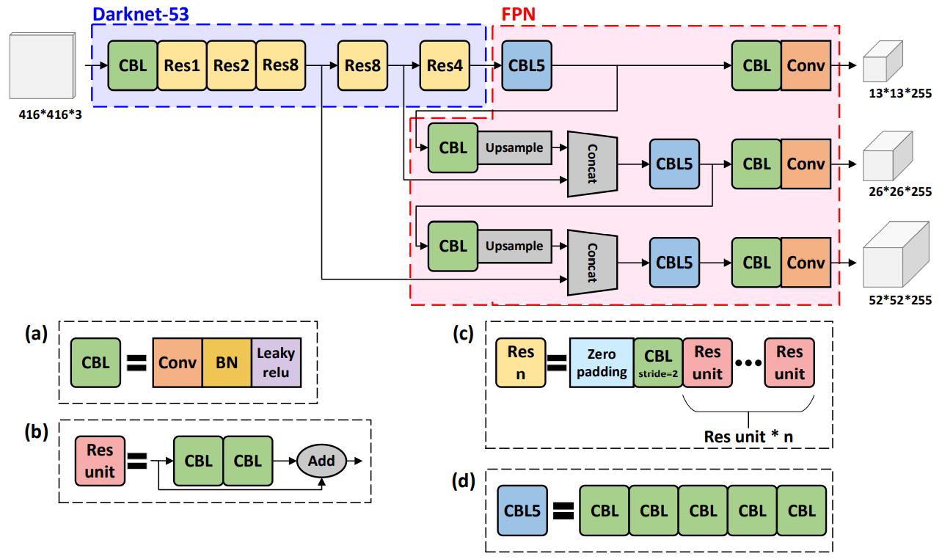
Original YOLO Network
10

Slide 12
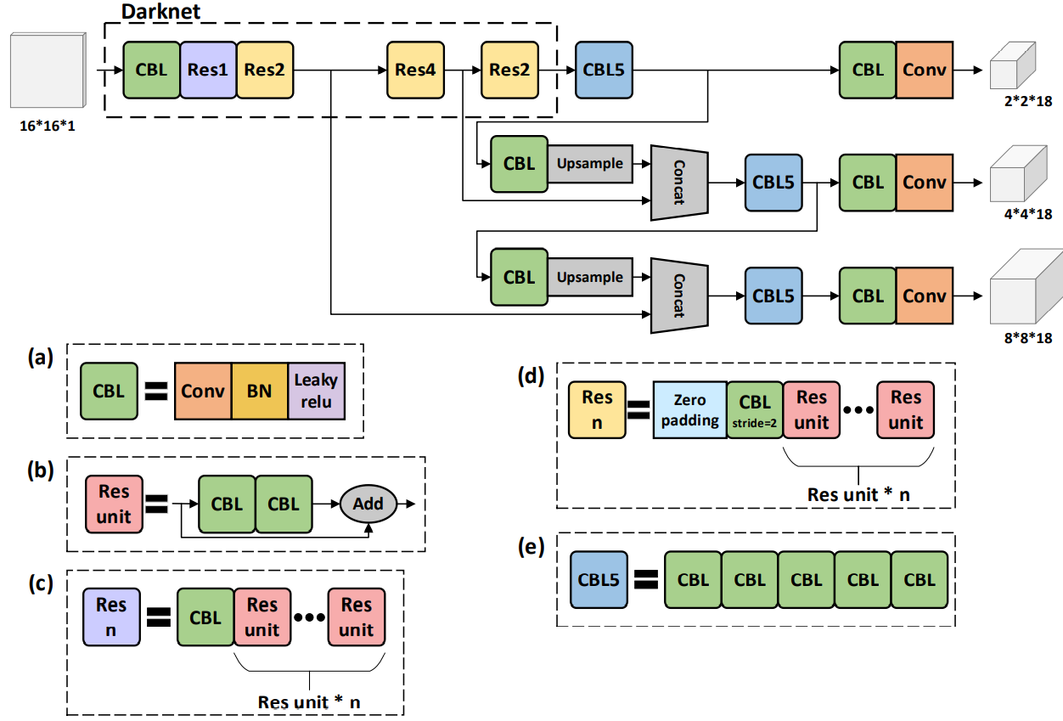
Simplified YOLO Network
– Simplified Darknet-53
– Reduce a residual block
– Reduce the number of
residual units in Darknet
– FPN remain unchanged
11

Slide 13
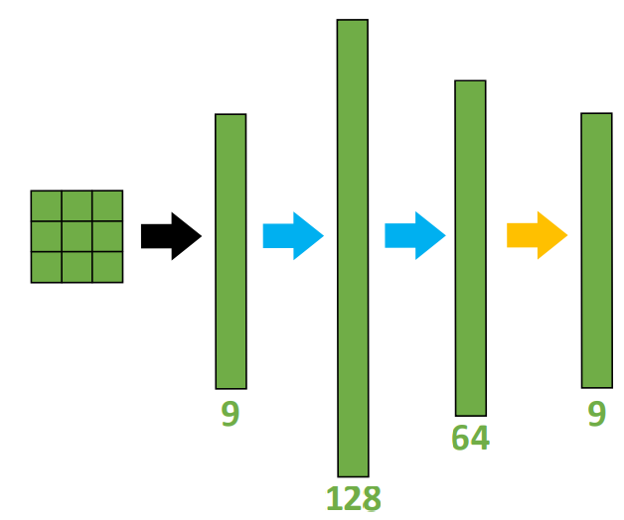
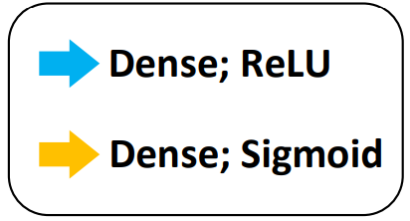
Concatenated DNN Classifier
– Leverage the performance in multi-target scenario
– Predict the probability that each cell in the bounding
box has a target
– which is a multi-label classification problem
– Activation function: ReLU, Sigmoid
– Loss function: Binary cross-entropy
12

Slide 14
Simulation settings
– Input RD map with size 16 x 16, and training, validation, and testing sets are with
size 200000, 60000, and 20000, respectively
(1) Compare 6 different CFAR detectors’ performances
– CA-CFAR, GO-CFAR, SO-CFAR, OS-CFAR, DL-CFAR, and YOLO-CFAR
(2) Under 3 different scenarios
– Single target (homo.), multi-target, and clutter (non-homo.) scenarios
(3) Using 2 different preprocessing techniques
– Truncating vs. DRC
(4) With or without additional DNN classifier
13

Slide 15
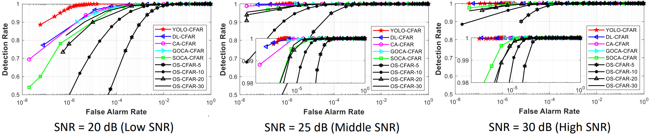
Simulation results
– Single target without clutter scenario and with SNR = 20, 25, and 30 dB
– if SNR > 30 dB, then the target can be successfully detected
[1] Y. L. Sit and T. Zwick, "Automotive MIMO OFDM radar: Subcarrier allocation techniques for multiple-user access and DOA estimation," 2014 11th European Radar Conference, 2014, pp. 153-156
14

Slide 16
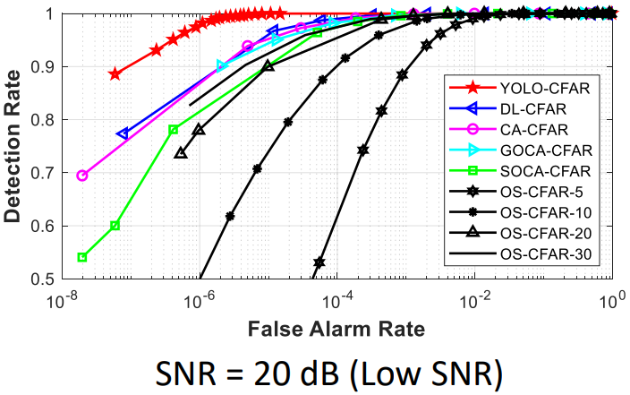
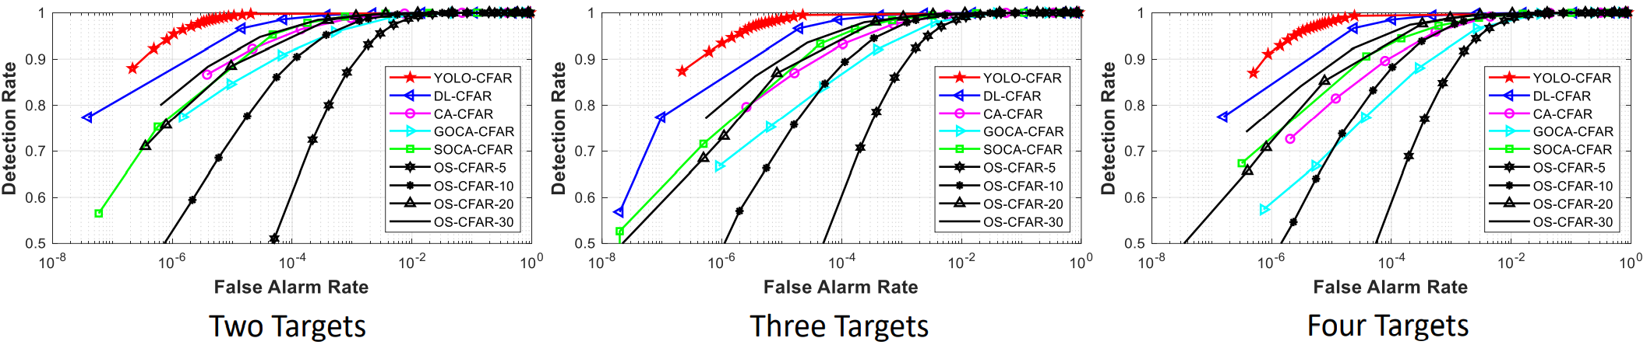
Simulation results
– Multi-target without clutter scenario
– SNR = 20 dB
15

Slide 17
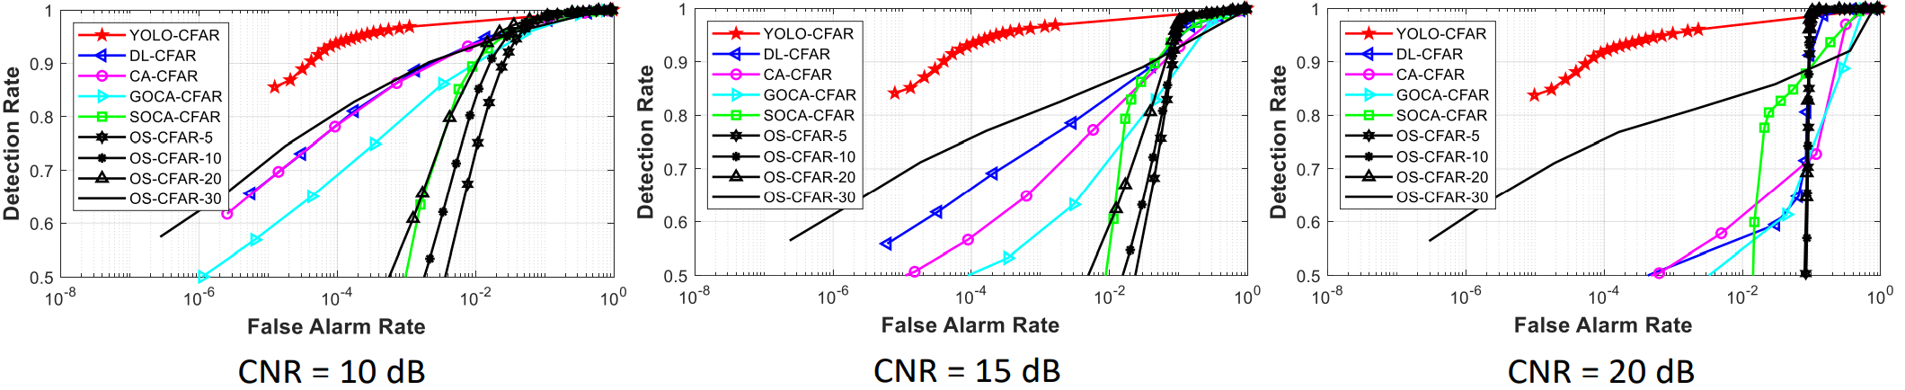
Simulation results
– Single target with clutter scenario
– SNR = 20 dB and CNR = 10, 15, 20 dB
16

Slide 18
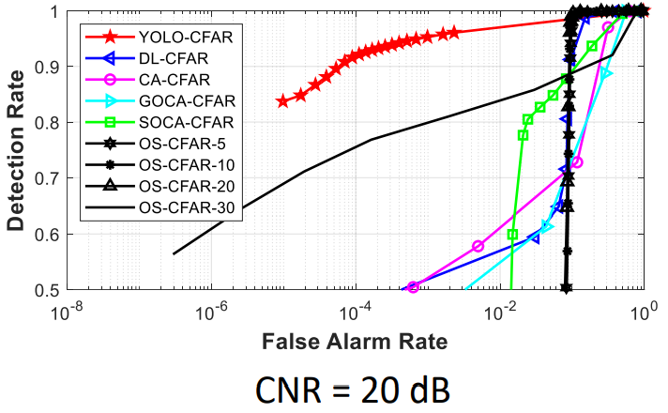
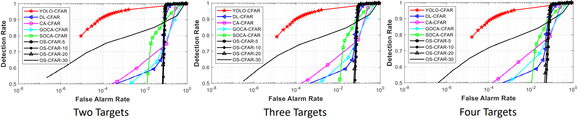
Simulation results
– Multi-target with clutter scenario
– SNR = 20 dB and CNR = 20 dB
17

Slide 19
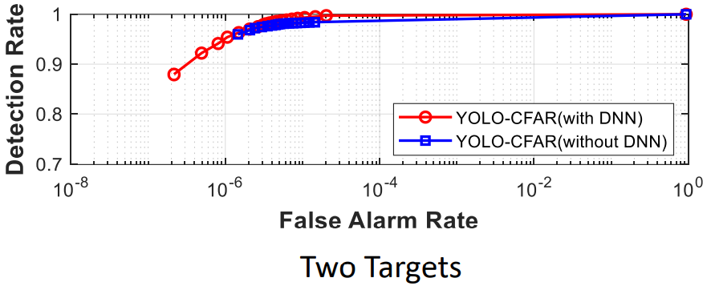
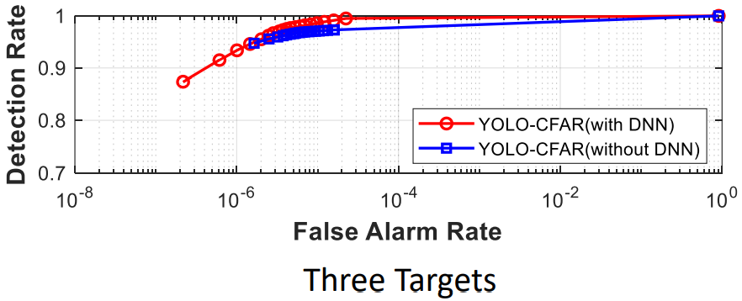
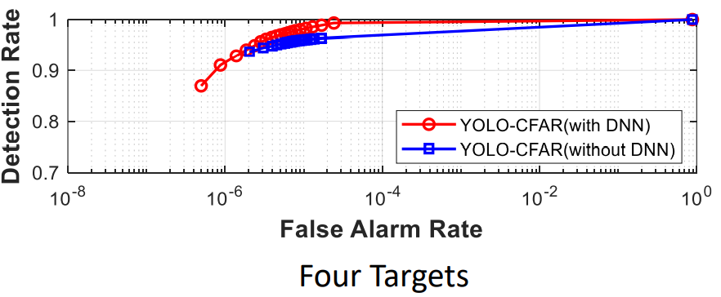
Simulation results
– Compare the performance of YOLO-CFAR with or without additional DNN classifier
– Multi-target without clutter and SNR = 20 dB
18

Slide 20
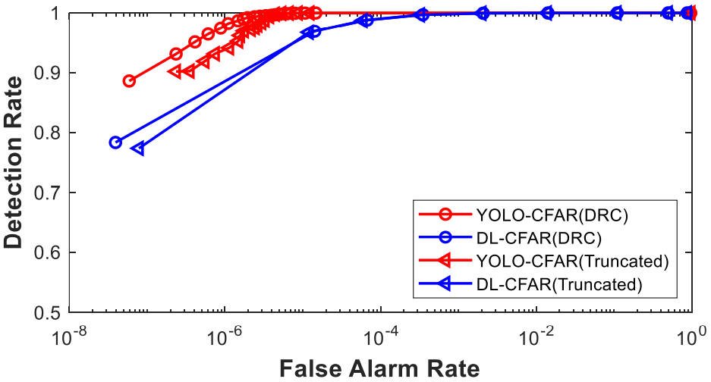
Simulation results
– Compare the performance when using DRC or truncating operator
– Single target without clutter and SNR = 20 dB
19

Slide 21
Conclusions and Future Works
– Summary
(1) Non-homo. scenarios can dramatically affect conventional CFAR detections
(2) YOLO-CFAR skipped the noise level estimation process
– Problems
(1) How they decide what to prune or simplified in the darknet-53?
(2) How they get 71 fps?
(3) None of the code works
20

Slide 22
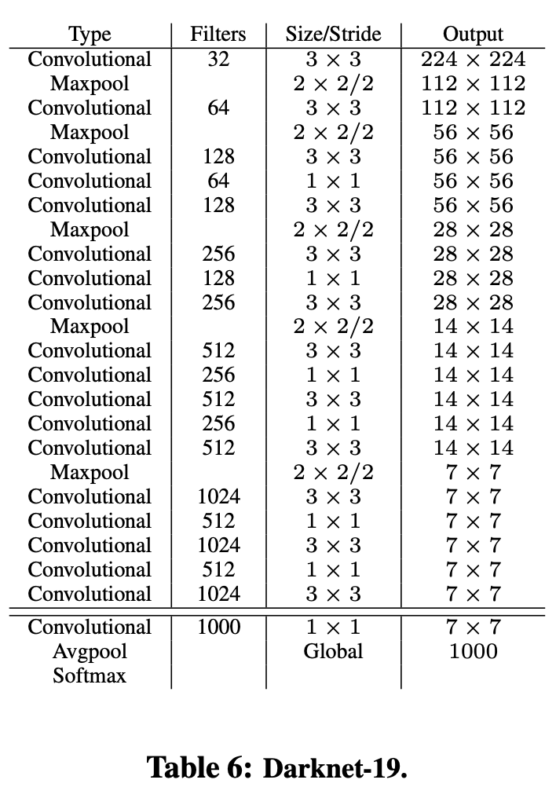
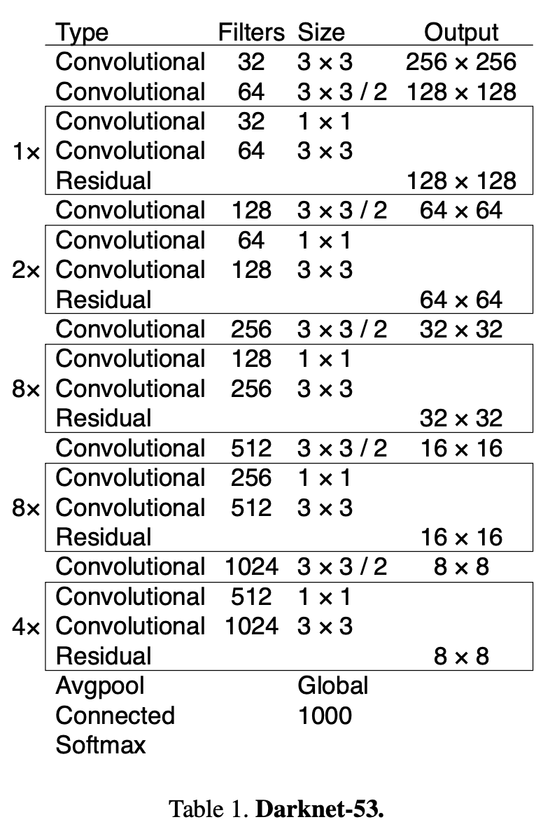

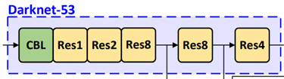
Appendix
– Darknet-19 vs. Darknet-53 simplified Darknet-53
21

